Slide 1





RECIPE MANAGER
MAAROF SAQR
(A23MJ4006)
Hasan Ammar
(A23MJ0018)
SAD PROJECT PRESENTATION
El Hassan Khattary
(A23MJ4002)
Mohamed G. S
(A23MJ0009)

Slide 2



01
INTRODUCTION
PROJECT INTRODUCTION: RECIPE MANAGER

Slide 3
ABOUT THE PROJECT
The Recipe Manager project plans to develop a convenient and comprehensive application to organize recipes and their data with ease. In realizing the difficulties that the cooking lovers encounter due to scattered and unsorted recipes through various websites, social media and other forums, this application is going to prove to be a boon for every cook.
Such functions include, but not limited to: creation, modification, and deletion of recipes, searching capabilities depending on the choice of specific ingredients or the kind of recipes. The focus of this project is improved UX, connection with social networks, and efficient data protection. Recipe Manager’s goal is to assist in decreasing the amount of time spent on various culinary tasks and contribute to the overall satisfaction of the meals’ preparation.

Slide 4
OUR OBJECTIVES
User-Friendly Interface: Ensure that the application offers basic and easy to navigate graphics for using the recipes database and the shopping list.
Recipe Management: Allow the users to create, modify, and delete recipes and let them search for recipes.
Personalized Recommendations: Provide meals that could be suggested based on the users’ profile and their previous actions.
Shopping List Generation: Able to create shopping lists for the selected recipes.
Integration with External Databases: Complete recipes from other databases are to be included into the recipe list.

Slide 5

02
PROTOTYPE
MAAROF’s PART

Slide 6
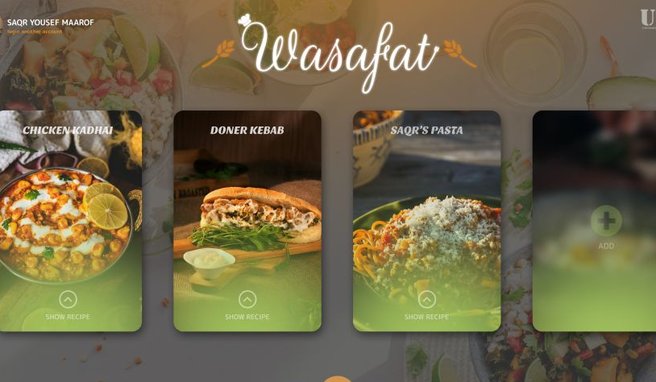
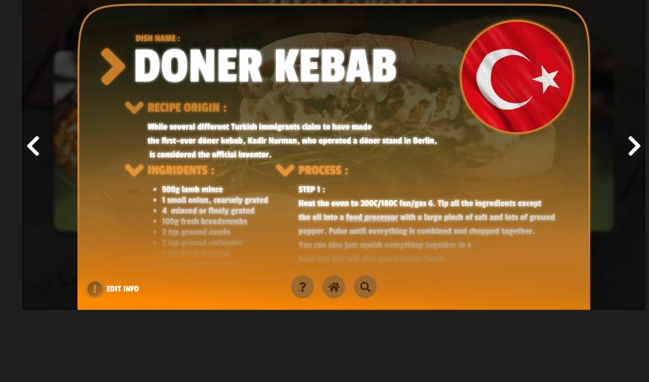
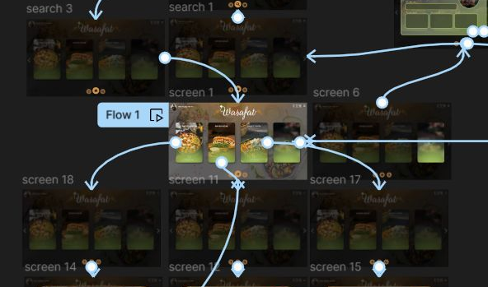
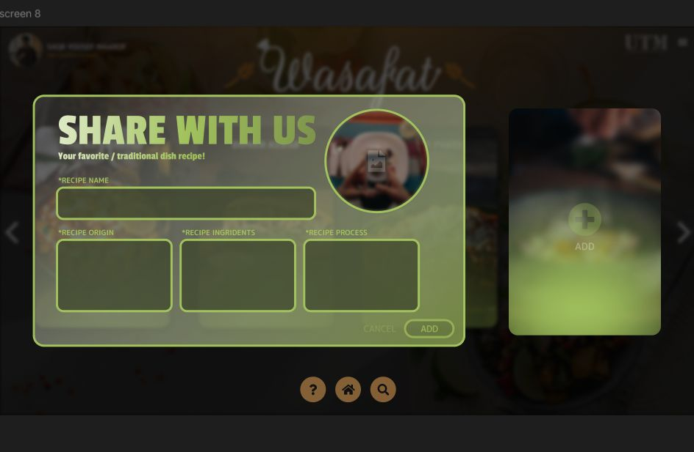
Divide the content in four ideas
Main screen
Recipe menu
Shows all options
Shows what does the user have of recipes
Interaction
Add button
Almost all parts interact
The user can add and search and also edit

Slide 7
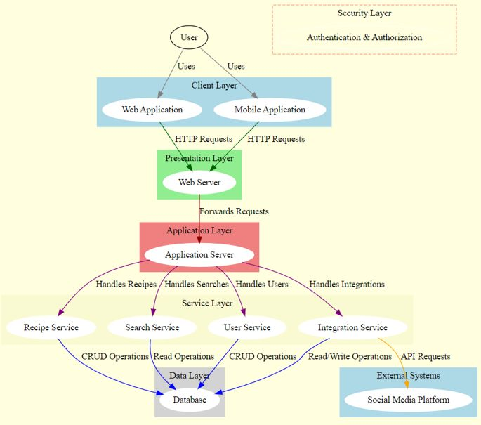

System architecture

Slide 8
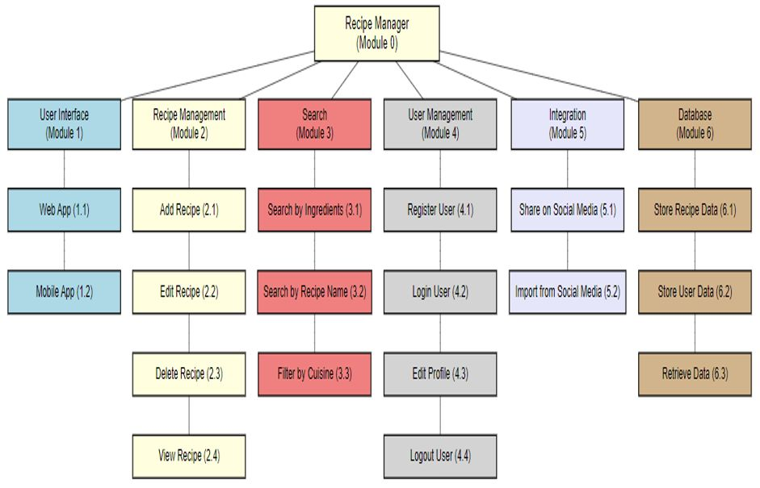
Structure chart

Slide 9



CONCLUSION

Slide 10
SUMMARY AND CONCLUSION
The Food Recipe Manager system is designed to streamline the management of culinary operations for users by offering features like recipe management, shopping list generation, and personalized meal recommendations.
With a user-friendly interface, it allows users to create, update, and delete recipes, and fetch recipes from external databases. The system also supports user profile management and provides detailed nutritional information for recommended meals.
Key non-functional requirements include performance, usability, reliability, security, and scalability. This system aims to make meal planning and grocery shopping efficient and personalized, enhancing the overall user experience by catering to individual dietary preferences and needs.

Slide 11

THANKS

